Slide 1

ITSM (JUMP)
Jump Tickets Manager v1.9

Slide 2
Summary
ITMS (Jump)
Definition
Jump Tickets Manager v1.9
Definition
Application presentation
Latest improvements v1.9
Q&A

Slide 3
Jump Tickets Manager v1.9
Definition
Jump Ticket Manager is a tool used to have a history of all solved tickets.
The purpose of the tool is also to find recurring incidents and the solution provided to solve the situation as quickly as possible.

Slide 4

Présentation de l’application
The application interface has 3 tabs
Arrived – the list of incidents that have already arrived and resolved also we can create new incidents
Created – here we will find the list of incidents that we create for others and we can create new ones
Stats – Live statistics

Slide 5
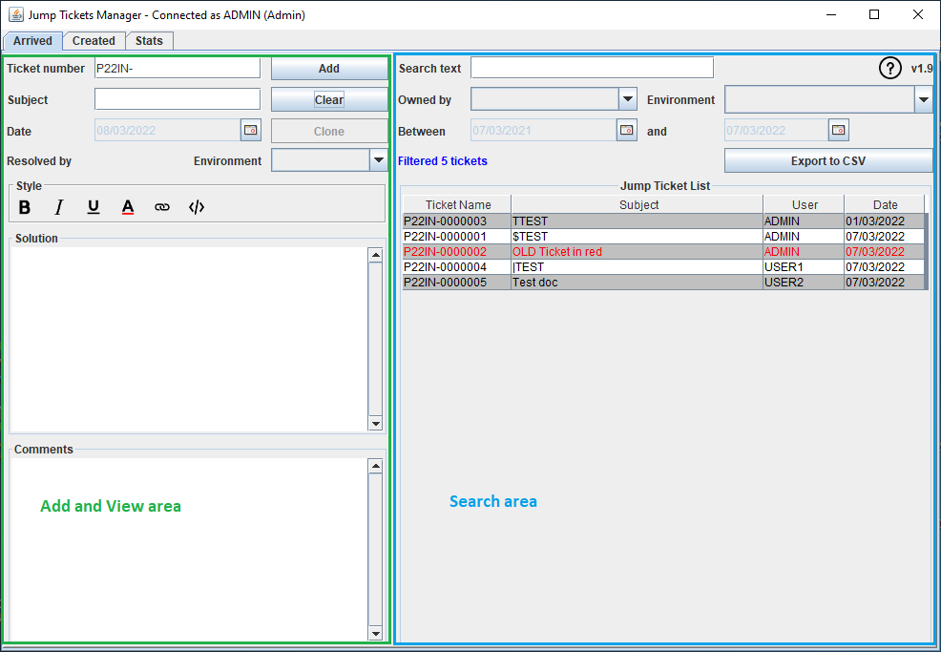
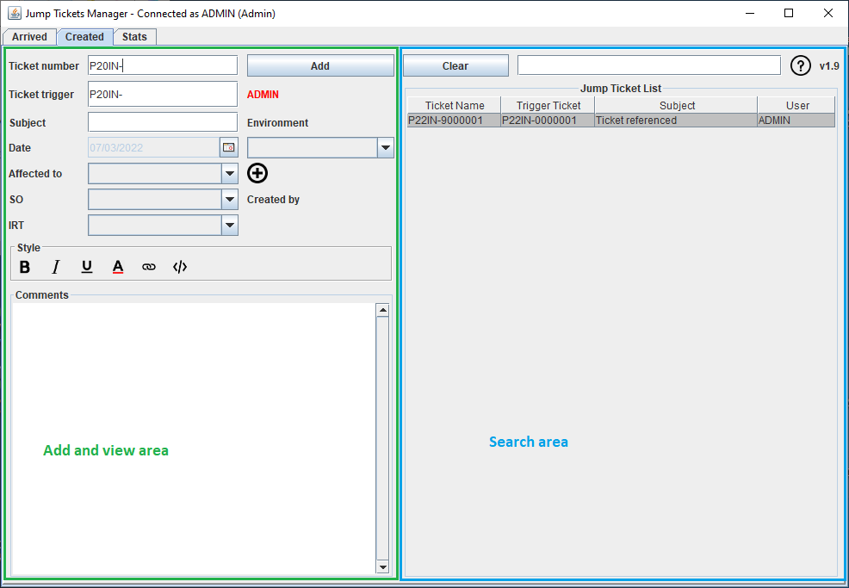
ARRIVED
The interface is divided into two
On the left in green the input area and
view ticket details
On the right in blue the ticket search area
CREATED
The interface is similar to the one before
On the left in green the input zone a
little enriched
On the right in blue the search area

Slide 6
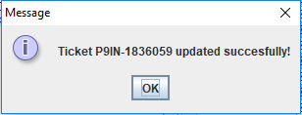
ARRIVED
Add and View area
Each new resolved incident must be entered under
Apart from the Comments all other fields are mandatory
Confirm entry with button
The registration of the ticket will be confirmed by the message
To erase the input area, press the button
Consult the help document with
Export filtered tickets directly with the option
Use the Clone button to create a new incident with the same subject, solution and comments

Slide 7
ARRIVED
Instructions:
The Date zone is automatically populated with today's date. If the incident is added later the Date must be that of the opening of the incident.
In the Solution and Comments areas you can pass the file you used to solve the incident (for example D:\Test Jump Manager.docx) – example P22IN-000005.
If you click on it, the document concerned will open.
If is your own ticket (then the Edit option is activated) and the document will open only with Ctrl + Left Mouse Click

Slide 8
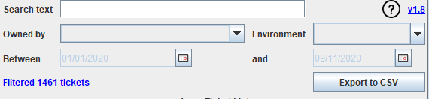
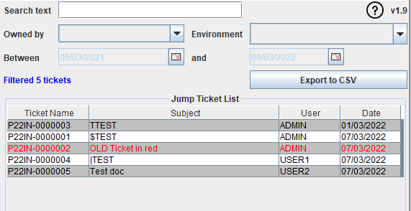
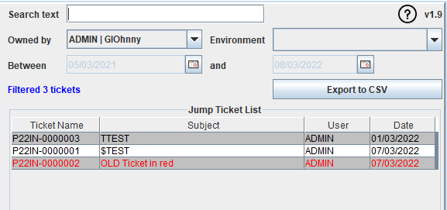
ARRIVED
Search area
New advanced search box from v1.8
Enter in the area after the Clear button and confirm with ENTER
The Jump Ticket List area will contain incidents that match your search.
Exemple
Full list Only my incidents

Slide 9
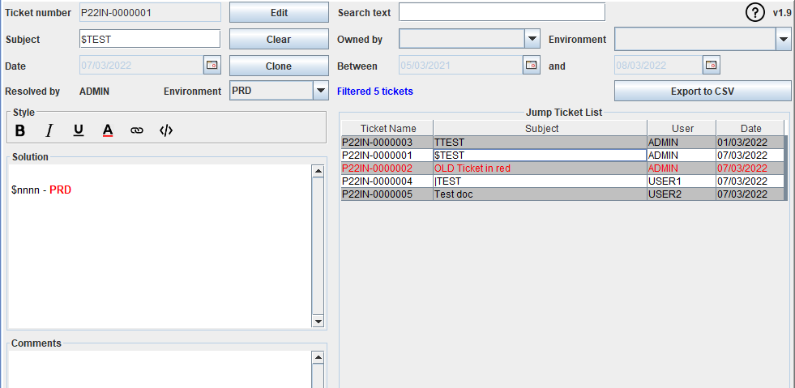
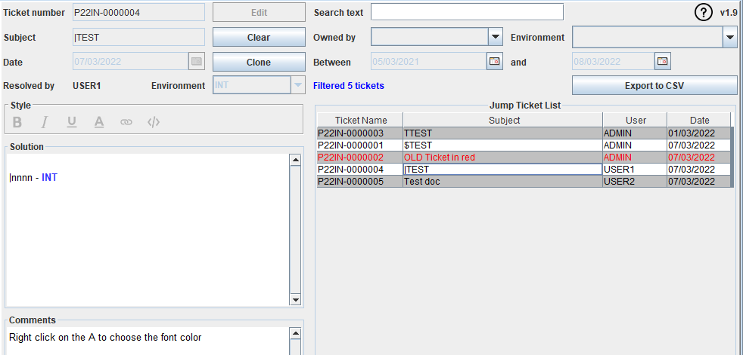
If you click on a line, the input area on the left will be
fed with incident details
Comments
- If the ticket is solved by yourself then the areas
will be editable (except Ticket Number) and if you wish
change things you have to confirm with the button
- Otherwise, the zones will only be in consultation

Slide 10
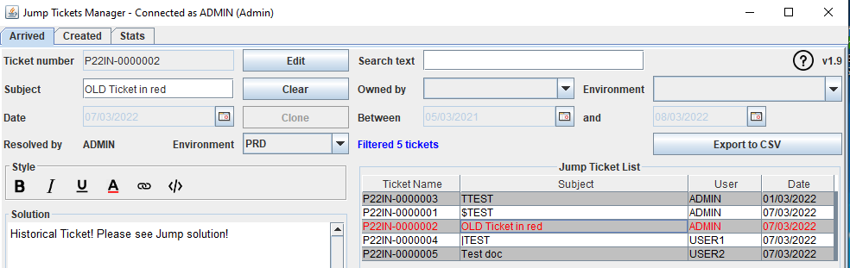

ARRIVED
Search
Every month, following a manual loading of the list of tickets
treated will be filled by the missing incidents.
The solution for these incidents is updated.
“Historical Ticket! Please see Jump solution!”
and then they go up in red in the list
To reset the filter, you must delete everything from the line of
search and validate with Enter

Slide 11

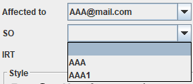
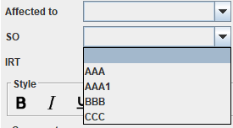
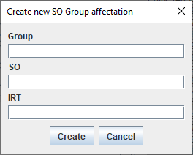
CREATED
Add and view
You must enter for any new incident created under ITSM to another team
Except Comments all other fields are mandatory
Confirm entry with button
The registration of the ticket will be confirmed by the message
To erase the input area, press the button
From v1.8 the Affected to, SO (TEAM) and IRT(TEAM Code) zones are no longer free zones for entry
Each choice will determine the values ​​loaded in the other 2 drop-down boxes
Exemple: If a mail is assigned to 2 teams then only these two will be available if you already choosed the Affected To
If nothing else was choosed then all values are available
If the value does not exist you can create a new Aff triplet. Group + SO + IRT with the located to the right of the Affected to.
WARNING! Any duplicates will be rejected!

Slide 12
Instructions:
The Date zone is automatically populated with today's date. If the incident is added later then the Date must be that of the opening of the incident.
In the Ticket trigger area, you must enter a ticket number that already exists in the list of resolved incidents ("Arrived"), so that you have already resolved.

Slide 13

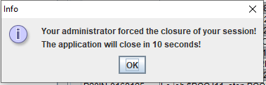
New features v1.9
Zone style
Select the text you want to format and then apply the style.
Instructions: Save the unformatted incident and do the formatting afterwards.
Logout
It is necessary to close the session of your application in the evenings.
Otherwise, as a precautionary measure an administrator can
kill the session to unlock the DB.

Slide 14

Q & A
For any information, bug or improvement proposal you can click on the version number
The email application will be opened with the Subject pre-filled (for security purposes in the Demo the mail is generic)

